Slide 1



The Digital Innovation Platform
IBM Bluemix
Notes:
Please note: Presenter notes are on every slide. Written as a suggested script to help with messaging.

Slide 2
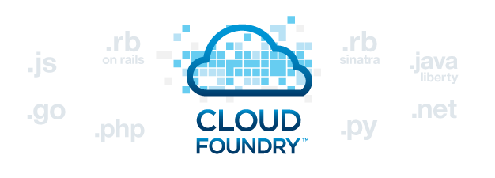


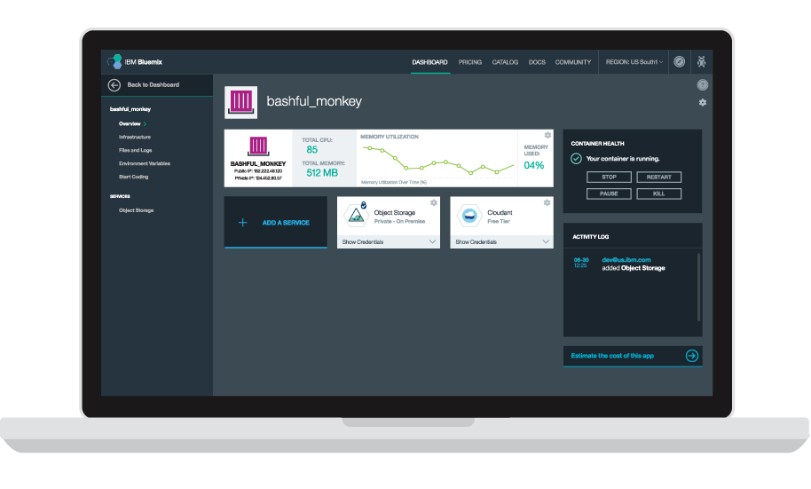










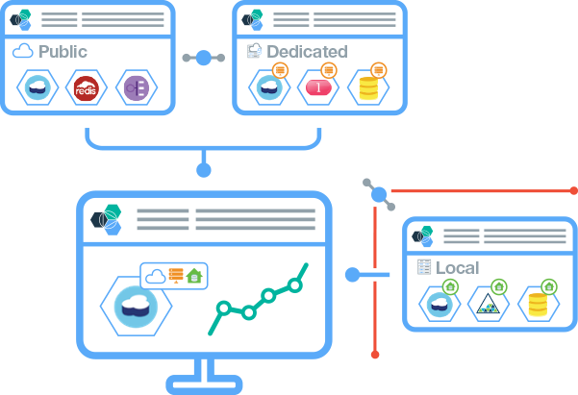
So what is Bluemix?
Bluemix is an open-standards, cloud-based platform for building, running, and managing applications.
Build your apps, your way
Use the most prominent compute technologies to power your app: Cloud Foundry, Docker, OpenStack.
Deploy and manage hybrid apps seamlessly
Get a seamless dev and management experience across a number of hybrid implementations options.
Scale more than just instances
Development, monitoring, deployment, and logging tools allow the developer to run and manage the entire application.
Layered Security
IBM secures the platform and infrastructure and provides you with the tools to secure your apps.
Flexible Pricing
Try compute options and services for free and, when you’re ready, pay only for what you use. Pay as you go and subscription models offer choice and flexibility.
Extend apps with services
A catalog of IBM, third party, and open source services allow the developer to stitch an application together quickly.
Coming Summer 2015

Slide 3

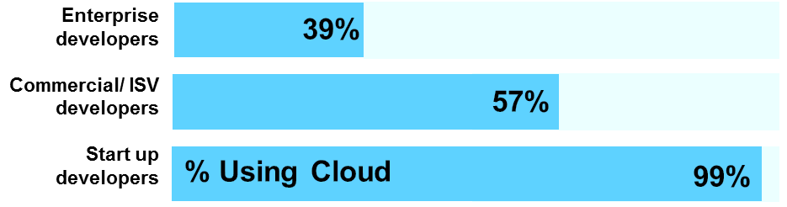
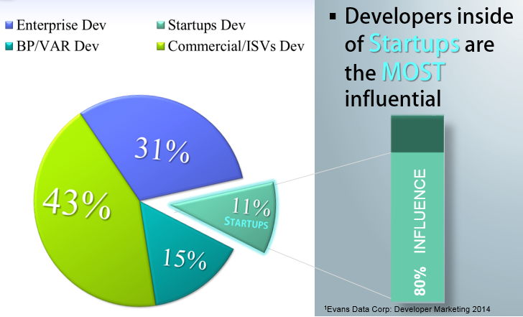


ISV and Startup developers will be critical to propel Cloud & Mobile Adoption
There are 18M developers worldwide³, of which 10M are developing on Cloud
Percent of developers developing on Cloud
Challenges
Developers are expected to have technical, communication and business skills¹.
ISVs will spend 10-20% of their yearly software revenue to move their software from on premises to cloud²
Influence
The number of developers is expected to grow to 23M by 2017
2/3 + of developers make / influence IT purchase decisions, with startups being the most influential³
Enterprise-ISV developers are influencing current purchases
Startup developers are shaping the next decade of IT opportunity
Preferences
Java is the #1 language worldwide¹
Over 49% of cloud developers prefer to have easy to navigate 'Self Help‘, available 24/7³
In addition to digital touch, developers also want a human touch¹
Top Countries for Developers in 2019
3
India
USA
China
Russia
Japan
Germany
3
Sources: ¹Gartner, ² GigaOm,³ Evans Data
Notes:
3

Slide 4




Why are developers using Bluemix?
To rapidly bring products and services to market at lower cost
Go from zero to running code in a matter of minutes.
To continuously deliver new functionality to their applications
Automate the development and delivery of many applications.
To extend existing investments in IT infrastructure
Extend existing investments by connecting securely to on-premise infrastructure.

Slide 5








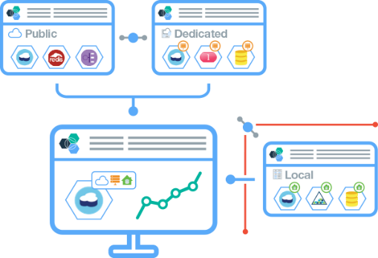


More openness and choice than ever before
Bluemix is anything but locked down. You choose how you build, deploy, and manage your apps. Bluemix takes care of the rest.
Compute
Dev Tooling
Choose the level of infrastructure abstraction based on your app’s architectural needs.
From editors to source code management to continuous delivery, you can use Bluemix’ powerful tooling or easily bring your own.
Location
Services
Deploy apps to Bluemix Public (in a growing number of geos), your own dedicated cloud Bluemix, or one that runs within your data center (Local*).
Pick from a catalog of IBM, third party, open source, or your own services to extend your apps.
IBM
Third Party
Open Source
Yours
*Bluemix Local coming Summer 2015
Notes:
Bluemix also allows flexibility when it comes to tooling - as, again, each developer has different preferences and needs.
Tooling Options:
IBM offers a web based integrated development environment (IDE) and associated git repository that allows quick deployments back to bluemix.
Developers can also edit code on their local machines (with the editor of their choice - i.e. Sublime) and deploy back to Bluemix through the cloud foundry command line.
Note to presenter: Other IDEs (like Eclipse, Cloud9) have direct integration with Cloud Foundry and can push code directly to bluemix, rather than a manual push by developer via command line. You may be asked about this.

Slide 6


Now you can get Bluemix in three unique yet fully connected delivery methods.
1 | Public
Maximize on cloud economics and agility.
2 | Dedicated
Everything is dedicated and connected to you — agility of public cloud, yet feels like home.
Seamless Hybrid Experience
Regardless of which combination (Public, Dedicated, Local) you choose, you can expect a single, seamless and portable experience.
3 | NEW: Local
Behind the firewall for the most sensitive workloads.
Coming Summer 2015

Slide 7

Bluemix – New services hot off the press!
IBM is adding more of its own technology into Bluemix, including:
Bluemix API Management allows developers to rapidly create, deploy, and share large scale APIs and
provides a simple and consumable way of controlling critical APIs not possible with simpler connector
services.
New mobile capabilities available on Bluemix for the IBM MobileFirst Platform, which provide the ability
to develop location-based mobile apps that connect insights from digital engagement and physical
presence.
Among the ecosystem and third-party services being announced today are:
Public availability of the .NET Runtime (preview) in IBM Bluemix and open sourcing of .NET Buildpack that
grants developers in any Cloud Foundry based environment the ability to leverage Microsoft's
development capabilities, making it easier to integrate multiple cloud workloads.
Namara.io platform by ThinkData Works aggregates and catalogues available open data into a single
portal, providing businesses, developers, and citizens with API access to high value information.
Cupenya Insights provides an analytics foundation that allows developers to connect and monitor
business activities across several Bluemix applications, define key performance indicators and receive
performance overview of the entire business process or supply chain.
flowthings.io by Flow Corporation collects real-time data and provides complex event processing, and
data delivery that makes it easier to integrate applications with almost any software or device in the
Internet of Things space.
Reappt from Push Technology delivers data at unmatched scale and speed over the Internet to give your apps a performance edge.
Underscoring developer choice and skill development of open source technologies as key tenets of cloud innovation, IBM is supporting the expansion of independent Cloud Foundry Dojo's by establishing the first IBM Cloud Foundry Dojo, located in Raleigh, NC.

Slide 8
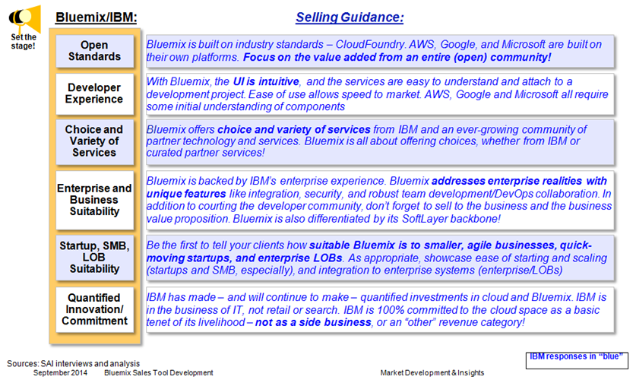
Set the stage and be proactive – highlight Bluemix capabilities that put many competitors at a disadvantage from the very start
Internal Use Only

Slide 9
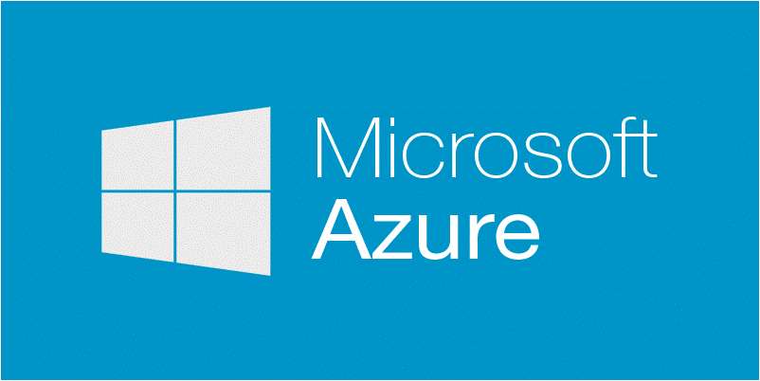




Bluemix Competitive Positioning
Vendor | Positioning | Open source? | Strength | Weakness | Marketplace/Services
Azure | IaaS/PaaS convergence, not separate. Offering PaaS public and on premise („local“) | No! Vendor lock-in | Strong in the enterprise market due to its legacy and existing penetration Hybrid cloud: well integrated with on-premises, complying to many regulations | Vendor login Microsoft – while it offers partner tech – is pushing its own franchises from end to end. | Offering a broad range of services in all areas, like mobile, business analytics, IoT and DevOps
Amazon | De facto Standard for IaaS, not PaaS, but many of the services available in AWS are comparable to services available in PaaS offerings No “on premise” offering | No! Vendor lock-in | Strong IaaS market penetration Low cost | True enterprise deployments are rare with AWS. No PaaS | While plentiful in AWS, services are mostly pre-installed VMs, therefore they are not easily integrate-able
Pivotal | Integrated platform with big data and open source PaaS Agile dev/tools ingrained part of Pivotal culture Available on premise | Yes Original authors of Cloud Foundry | Hybrid Cloud: Public as well as on premise offering (runs on premise on VMware infra, OpenStack) No vendor login due to cf Well positioned in enterprise market | Limited availability of public PaaS (Pivotal Web Services): PWS exists on AWS US East with no apparent near future plans to deploy worldwide. | Pivotal boasts a growing set of add-on services, but their marketplace in terms of depth and breadth is by far smaller than IBM’s
Heroku | PasS that gained great mindshare with the development community. Running on the Amazon cloud (IaaS): Have been acquired by Force.Com, so far no integration No “on premise” offering | No! Vendor lock-in | Heroku seized impressive early mindshare with the development community, and enjoys a loyal following. | Not enterprise class. The infrastructure may scale (Amazon), but Heroku apps don't; customers contracting with three vendors instead of one: Heroku, Amazon and Salesforce. | A very broad range of add-on functionality/services from different vendors. Many of them wouldn’t scale in Enterprise scenarios
Google | PaaS with sweet spot remaining the newer cloud-based developer unencumbered with legacy systems; though enterprise is also targeted. No “on premise” offering | No! Vendor lock-in | Halo of Google’s reputation for technological prowess and innovation impacts cloud product perception Low cost | Few choices on runtimes, database options, add-on services – negative impact on enterprise readiness | Few choices on runtimes, database options, add-on services
Internal Use Only

Slide 10
Pricing Models

Slide 11
Business Model and Pricing Summary
FREE TRIAL | PAY AS YOU GO | SUBSCRIPTION | ELA |  | SUPPORT
30 day trial No credit card required Unlimited access to all services and Support (for now) | Flexible, cancel anytime Consumption based price metrics (compute, data, mobile, security) Competitive to market No cannibalization to on-premise Easy for customer to understand Free tier available | 6/12/36 months Up to ~35% savings vs. Pay-As-You-Go plan Minimum spend $500/month (different in other currencies/ countries) Flexible billing Free tier available | Include in an ELA as PA SaaS Subscription |  | Two support options Community free Support Paid support - 24x7 phone, email, chat 10% of list, $200/month minimum (different in other currencies/ countries)
Allow developer to create applications that consume 2GB of runtime and 20 services, 500 routes
11

Slide 12
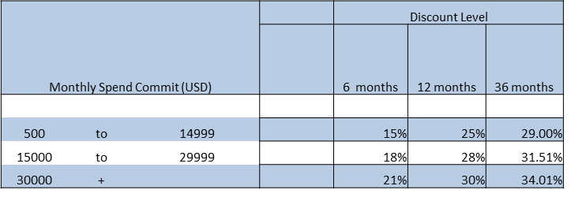
Bluemix Public Pricing
Bluemix Public is based on monthly usage of the run times and services
Run Times:
You are charged for the time that your apps run and the memory that is used, calculated as GB-hours.
Many run-times have a free level and you are not charged until you exceed that.
Services:
Some of these features charge a fixed monthly plan price, and others charge for metered use.
For monthly plans, you pay a flat rate per month, for a specified amount of usage.
For metered services, you pay based on your monthly consumption of the service.
Bluemix Public Subscription Fees
Provides discounts based on level of monthly commitment and length of term
Essentially gives client $X Bluemix usage for $X minus Discount Payment. Ex: you get $1000 usage and pay $750 for a 12 month term Bluemix Public Support Fees
10% (or $200 whichever is greater) of monthly usage fees based on the $Bluemix Usage, not discounted amount

Slide 13
RESOURCES - Where to Find More
Monthly Bluemix Product Updates http://ibm.co/1FgkoSX
Follow Bluemix on Twitter + YouTube
Bluemix Sales Wiki - https://ibm.biz/BdXdW2
Bluemix External Presentation - https://ibm.biz/BdXR2Y
Bluemix Hackaton Details - https://ibm.biz/BdXR2y
Competitive landscape >>> https://ibm.biz/BdXDbD
Customer references presentation >>> https://ibm.biz/BdXDbq
IBM Bluemix — Platform-as-a-Service Vendor Profile IDC >>> https://ibm.biz/BdXDbF
Gartner Magic Quadrant >>> https://ibm.biz/BdXDbP

Slide 14
Bluemix Return on Investment
Based on >60 GBS IT pilots.
Development Activities |  | Traditional App Dev | Bluemix Advantage
Quick Time to Value | Development Time | 4 - 5 Weeks | 1 - 2 Week Savings
 | Platform Provisioning | 2 weeks - 3 Months | Instant Provisioning
 | Deployment Components | 3 - 4 Weeks | 2 - 3 Days
 | Application Installation in Production | 2 - 4 Weeks | 2 - 3 Days
Scalability | Performance Testing (environment + app. Deploy + testing) | 4 - 5 Weeks | Instant Provisioning + 2 - 3 Days depoyment
 | New Rollouts | Need additional provisioning (4-6 Weeks) | Instant Reprovisioning
Integrated Channels | SW dependencies | Need new components / SW | Components available as Services
 | Build New Channels (Mobile, Portal, etc…) | Need new components | In Build Services can be leveraged
 | Re-usability (business layer) for Integrating new channels | 30% - 50% Reuse | 60% - 70% Reuse
Ecosystem for New Ideas (Harvest / Innovation) | Ability to replicate environments with Data | 6 - 8 Weeks | 1 - 2 Weeks for Both Provisioning (image restore) & Rapid Application development (tweaking)
 | Develop POC / New functionalities | Time Consuming
Externalize Broadcasts | Pushing Data to Services | Custom or Partner with Providers | Use Standard Push Notiifcation Service to push updates, etc…

